Slide 1
Direct Electron-Beam Injection Experiments for Validation of Air-Chemistry Models
S.B. Swanekamp, J.R. Angus, D. Mosher*, P.F. Ottinger*, A.S. Richardson, and J.W. Schumer
Plasma Physics Division, Naval Research Laboratory, Washington DC 20375
Presented at the EuroAsian Pulsed-Power Conference
Estoril, Portugal
Sept. 17-23, 2016
*Independent contractor to NRL through Engility Corp., Alexandria, VA 22314

Slide 2
There are 3-facilities at NRL where air-chemistry is currently being studied
A low-voltage arrangement to study SGEMP
Febetron is used to generate 100 kV, 5 kA, 90 ns pulses
Interaction volume on the order of 10×10×10 cm³
A higher voltage arrangement in a large “space” chamber to study SREMP
Febetron is configured to provide a 200 kV, 10 kA, 90 ns pulse
Interaction volume on the order of 200×200×200 cm³
Gamble II is used to generate a 1 MeV, 800 kA, 50 ns beam for material response studies
Interaction volume on the order of 10×10×10 cm³
<< 1 kA/cm²
~10 kA/cm²

Slide 3
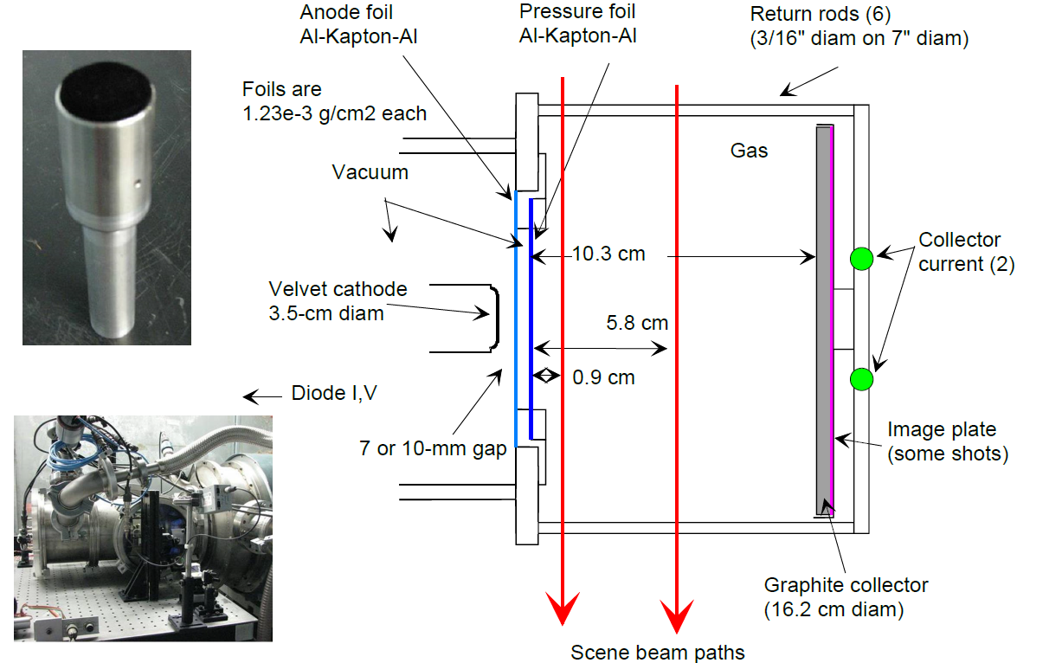
The low-voltage arrangement is used to validate SGEMP

Slide 4
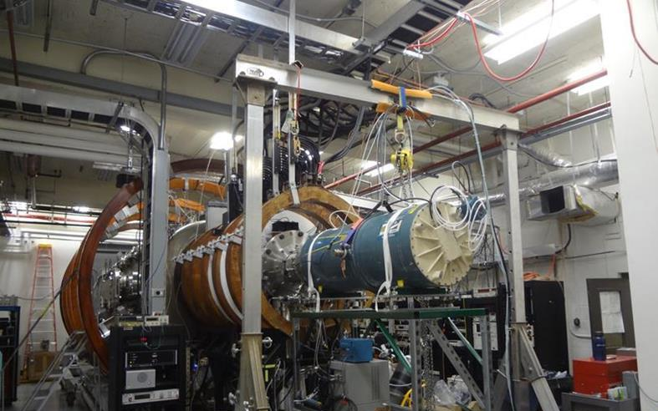
A large 2-m diameter “space” chamber to simulate SREMP
200-kV beam into space chamber for SREMP

Slide 5
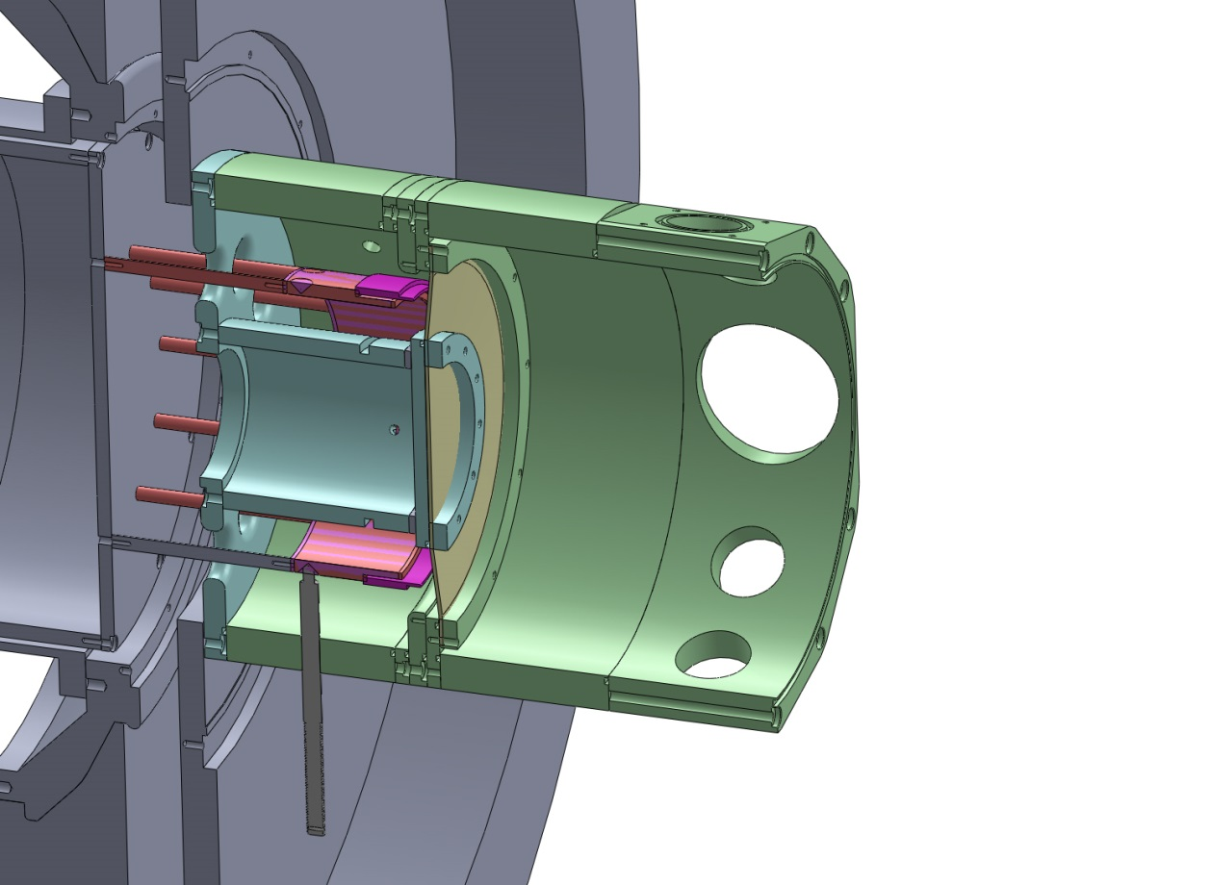
Ring diode experiments on the Gamble II produce 800-kA, 1-MeV ebeams with J_{b}>10 kA/cm²
Gamble II Ring Diode
Ring Diode Electrical Characteristics
Gamble II
door
10-cm radius
beam
I/2
anode foil
shot 10765
shot 8141
7-cm radius
beam
Gamble II
(-) center
conductor
I/2
e⁻
ring
cathode
e⁻
A-K gap
0.1-10 Torr N₂
diagnostic
spool
J_{b} exceeds 10 kA/cm² at the entrance to the gas cell
High current density supported by x-ray images
insulator
Transport Diagnostics
An axial pinhole camera (PHC) images x-rays from the anode plane and endplate
B-dot sensors inside the gas cell measure net current
Laser interferometry measures line-integrated electron density along a diameter
Time-resolved spectroscopy measures lines from various species

Slide 6
Gases with pressures of 1-10 Torr provide charge and current neutralization for intense propagating ebeams
Both charge neutralization (n_{e} > n_{b}) and current neutralization (I_{n} = I_{b} - I_{p} <I_{A}) are needed to transport beams with currents exceeding the Alfvén current I_{A} = 17 βγ kA over distances much larger than the beam radius.
Beam-impact ionization breaks down the initially-neutral gas, creating a conducting plasma
The plasma electrons gain energy from the inductive electric field produced by the time-varying net-current I_{n} , causing further ionization through thermal processes.
Applications
Intense electron-beam transport for material-response studies
Gas-discharge studies
E-beam propagation in air
Systems-response studies
Radiography
Nitrogen is the natural gas to use in the ABC model

Slide 7
A new gas-chemistry model is needed for these high-current density beams
Weakly ionized model [1,2]
ν_{e-n}>>ν_{e-e} so that eedf determined by the inelastic energy-loss collisions (n_{e}<0.01 n_{gas})
Chemistry is relatively simple because electrons always interact with neutral gas in the ground state
Ground state N₂
e+N₂ → e+N₂*
e+N₂ → e+N₂⁺
NO Stepwise ionization
e+N₂* → e+N₂⁺
NO Dissociative recombination
e+N₂⁺ → 2N
NO additional chemistry for atomic nitrogen needed
Momentum transfer occurs through elastic collisions with neutral gas
Advanced breakdown and conductivity (ABC) [3]
ν_{e-n}<<ν_{e-e} so that eedf is Maxwellian (n_{e}<0.01 n_{gas})
Chemistry is more complex and electrons can interact with excited ground state as well as reaction products
Ground state N₂
e+N₂ ↔ e+N₂*
e+N₂ → e+N₂⁺
Stepwise ionization
e+N₂* → e+N₂⁺
Dissociative recombination
e+N₂⁺ → 2N
Additional chemistry for atomic nitrogen needed
Momentum transfer occurs through electron-ion collisions rather than electron-neutral collisions
1) D. McArthur and J. Poukey, PRL, 27, 26 (1971), and Phys. Fluids, 16, 11 (1973)
2) D. Welch, et al., Phys. Plasmas 1 (1994)
3) J. Angus, et al., Modeling nitrogen plasmas produced by intense electron beams, Physics of Plasmas, 23, 053510 (2016)

Slide 8
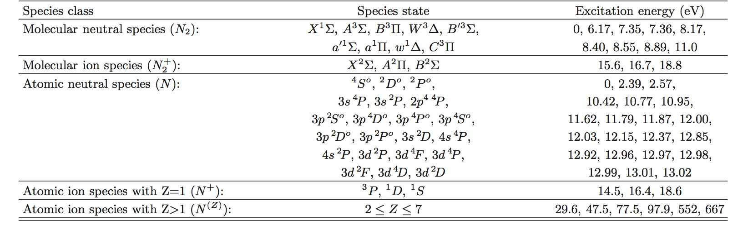
The ABC model contains 42 different nitrogen species to include the important kinetic processes
swarm
Energies for molecular excitations and Z = 1 atomic-species excitations are with respect to the molecular ground state
Excitation (ionization) energies of atomic species with Z > 1 are with respect to the Z = 1 ground state
Species set is sufficiently inclusive to
Describe the transition from weakly-ionized and molecular to strongly-ionized and atomic
Determine the role of step-wise processes to ionization and dissociation
Predict the production rate characteristic line radiation from N₂, N₂⁺, and N species

Slide 9
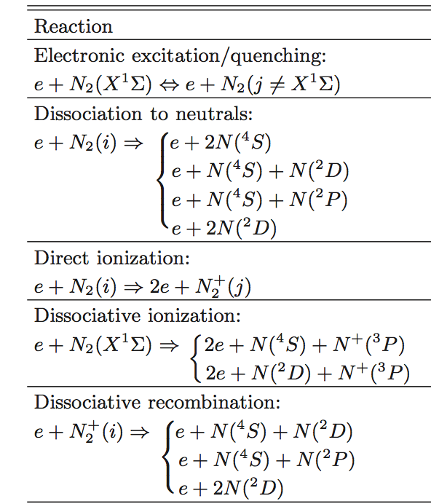
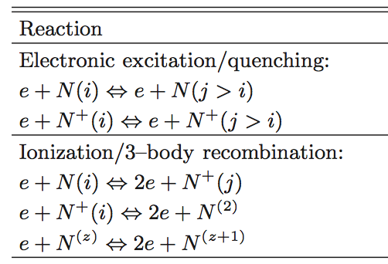
Thermal electron reaction rate constants are computed using energy-dependent cross sections
Molecular Reactions
Atomic Reactions
1
5,6
1,2
7,8
1,3
Rate Constants
1
Y. Itikawa, J. Phys. Chem. Ref. Data, Vol. 35 (2006)
P. Teulet, et al., J. Quant. Spect. & Rad. Trans. 62 (1999)
A.V. Kosarim, Chem. Phys. Lett. 414 (2005)
J. Peterson, J. Chem. Phys. 108 (1998)
Y. Wang et al., Phys. Rev. A 89 (2014)
R. Henry et al., Phys. Rev. 178 (1969)
Y. Kim and J. Desclaux, Phys. Rev. A 66 (2002)
W. Lotz, Z. Physik 216 (1968)
4

Slide 10
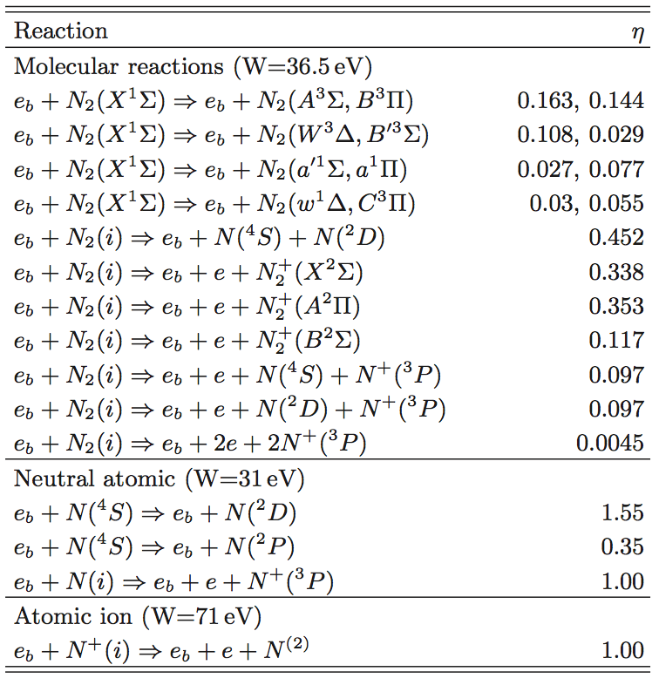
Beam-impact reactions are described using the stopping-power formalism^{1,2}
Energy needed to produce an electron-ion pair W, and production efficiencies η for molecular and atomic nitrogen are given by Slinker, Taylor, and Ali ^{1,2}
Beam-impact contributions to the rate equations for each species are from
This formalism accounts for both direct beam-impact ionization and ionization produced by intermediate energy (~ 60 eV) secondary electrons as they relax to thermal energies
W and η are basically constant for electrons with energies of 1 keV to 1 MeV
Bethe stopping power in 1-Torr nitrogen for energies between 0.1 and 1 MeV is between 6.4 and 2.8 eV/cm
Beam-impact reactions do not perturb the beam in a 10-cm-long transport cell
R. Taylor, et al., J. Appl. Phys., Vol. 64, no. 3, pp. 982-993, (1988).
S. Slinker, et al., J. Appl. Phys., Vol. 67, no. 2, pp. 679-690, (1990).

Slide 11
The parameter regime of the GII experiments permit the use of simplifying assumptions in nitrogen plasma modeling
Pressure is high enough that plasma electron collisions are local (small mean free path)
The ionization state is sufficiently high early in the pulse so that
background electrons are approximately Maxwellian (ν_{e-e} > ν_{e-n} > 1/τ_{b})
rate equations are dominated by electron-impact reactions (can ignore heavy-heavy reactions and photon-induced reactions)
The plasma is stationary on the hydrodynamic time scale of J_{p}×B and ambipolar diffusion
Thermal energies during the molecular phase are high enough so that ionization, dissociation, and electronic excitation dominate over vibrational and rotational excitations
Parameter Regime of GII experiments

Slide 12
Time-dependent plasma behavior in ABC was tested with a 0D circuit model and rigid-beam approximation
Good charge and current neutralization in many GII experiments allow the beam to travel ballistically through the gas cell
Assume the ring beam travels rigidly in z between radii r₁ and r₂ in a cell with conducting walls at r_{w}
Assume J_{b} and J_{p} = σ_{p}E_{z} are axially invariant and uniform between r₁ and r₂ with area A_{b}
The beam-plasma system is modeled as an simple L-R circuit with a time-dependent conductivity σ_{p}(t) driven by a time-dependent beam current J_{b}(t)
The ABC model is used to compute the plasma conductivity σ_{p}(t)
OD rigid beam model

Slide 13
The ABC model extends nitrogen gas chemistry to high electron-beam current densities
Weakly
Ionized
Coronal regime
ABC
-

Slide 14
The plasma current history from simulation is in good agreement with that from experiment
Plasma current is nearly equal to beam current since the current neutralization factor is small (f_{n}=I_{n}/I_{b}<<1)
Experimental and simulated net current agree within about a factor-of-two
Net current measurements and modeling have possible errors due to
experimental: low measured currents in a difficult plasma environment
OD ABC modeling: rigid paraxial beam can’t respond to net-current B field and will not have correct injected angular distribution
Plasma current is the important parameter for background plasma modeling since Joule heating is the main power source
Net current is important for beam pinching

Slide 15
The net current is ‘frozen in’ at a small fraction of the beam current early in the pulse
Simulation parameters
Inner and outer beam radii r₁=6.5 cm and r₂=7.5 cm
gas cell radius r_{w}=10 cm
p=1-Torr N₂
Conductivity rises over the entire beam pulse
Beam current about 95% neutralized by the plasma return current
I_{net} = I_{b} - I_{p}

Slide 16
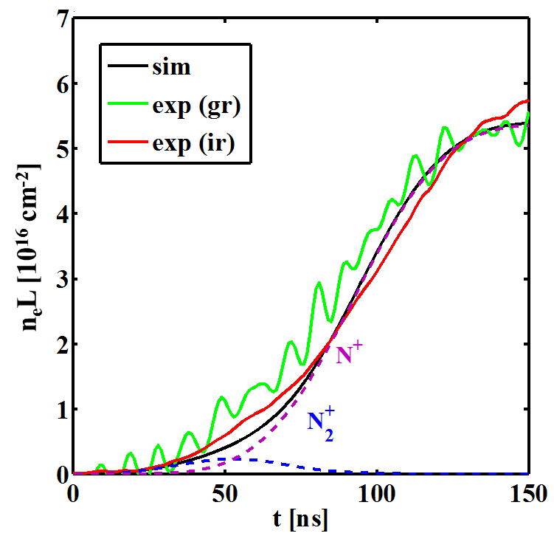
n_{e}L from simulation is in good agreement with experimental n_{e}L measurements
Experimental n_{e}L measured across beam diameter with a two-color interferometer² (green at λ = 532 nm and IR at 1064 nm)
Phase shift proportional to density
Phase shift transitions from molecular ions to atomic ions over the beam pulse
Plasma ions are mostly atomic during the last 100 ns
Comparison of Simulated and Experimental Line Densities

Slide 17
The gas transitions from weakly-ionized molecular to strongly-ionized atomic over the current pulse
Molecular nitrogen density is mostly gone by the end of the pulse
The gas is mostly atomic during the latter half of the pulse
Electron momentum-exchange is dominated by collisions with neutrals during the first 50 ns, then by collisions with ions for the rest of the pulse
⁻³]

Slide 18
Electron temperature is determined by a balance of Joule heating P_{J} and inelastic losses
Beam heating P_{b} is negligible in comparison with Joule heating
The energy sink is dominated by inelastic collisions with ground and metastable states
molecular ground state N₂(X¹) early in pulse
neutral atoms N(⁴S,²D,²P) near peak current
atomic ions N⁺(³P,¹D,¹S) near end of pulse
Energy Balance
T_{e} spikes early in the pulse due to the large inductive electric field of the un-neutralized beam
During the weakly-ionized phase T_{e} = T_{e}(E/P)
Reduced electric field remains below the runaway value of about 1.25kV/cm/Torr
Temperature History

Slide 19
Ionization and dissociation are dominated by processes with high-lying excited-energy states
Ionization potential of ground state atomic N is 14.5eV
Numerous optically-allowed states of neutral atomic nitrogen have energies between 10.4 eV and 13 eV
Dissociation potential of N₂(X¹Σ) is 9.75 eV
Dissociation to atomic species initially goes through the ground state N₂(X¹Σ), but proceeds mostly through N₂⁺ and excited N₂(*) states as their populations grow
total
total

Slide 20
The OD ABC simulations reproduce experimental scaling trends of n_{e} and f_{n}=I_{net}/I_{b} with pressure
Both n_{e} and f_{n} show modest increase with pressure in range 0.5 to 10 Torr
0D results using new gas-chemistry model are in much better agreement with old experiments than a previous 2D LSP model¹ using
PIC beam particles
a weakly-ionized gas-chemistry model
dissociative recombination turned off
For these data, I_{net} from the ABC model is lower than the experiment by a factor of 2-3 for pressures near 1 Torr
1) S. Strasburg, et al., Phys. Plasmas 10, 9 (2003).

Slide 21
Agreement between simulated and experimental I_{net} is improved on some recent shots on GII
shot 10765, P = 1 Torr
shot 10766, P = 5 Torr
Similar diode voltage and current profiles with a 10-cm radius ring diode
Redesigned B-dot monitors may have helped to improve agreement
May need to model the diode and anode foil to get correct beam angular distribution injected into gas cell
2D hybrid simulation in LSP with the ABC can model the self-consistent response of the beam to the evolving electromagnetic fields

Slide 22
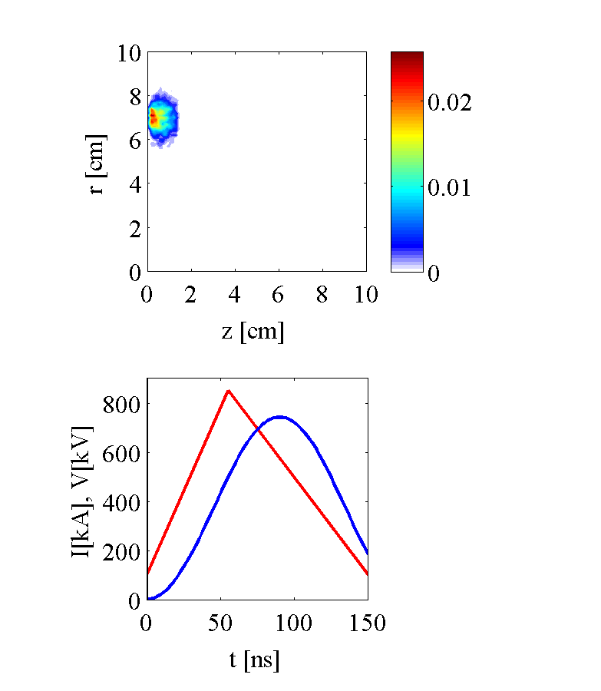
2D hybrid simulation with LSP shows good transport in 1-Torr nitrogen over 10 cm
J_{b} [kA/cm²]
ABC model for background plasma
PIC for beam particles
10 particles/dr/dt
dr = dz = 1 mm
Explicit in time (C_{m} = 0.9)
0.5-mil Ti foil at entrance
Same parameters as considered in 0D simulation
Diode voltage and current profiles for beam energy and current injected at z=0
Δr_{b} = 1cm, r_{b} = 7cm
V_{b}
I_{b}

Slide 23
Background plasmas at 1 Torr from 2D LSP simulations agree with the 0D modeling
Results at t = 80 ns
Results at r = 7 cm, z = 1.3 cm

Slide 24
Electric field and net current from 2D LSP simulations agree with the 0D modeling
Results at t = 80 ns
Results at r = 7 cm, z = 1.3 cm

Slide 25

2D LSP hybrid simulation shows poor transport in 10-Torr nitrogen over 10 cm
J_{b} [kA/cm²]
Other than pressure, same simulation as 1-Torr case
Transported beam shows pinching and hose-like instability
Explained by insufficient current neutralization due to lower temperature and conductivity¹
V_{b}
I_{b}
R.B. Miller, “Introduction to the Physics of Intense Charged
Particle Beams,” Plenum Press, New York (1985).

Slide 26
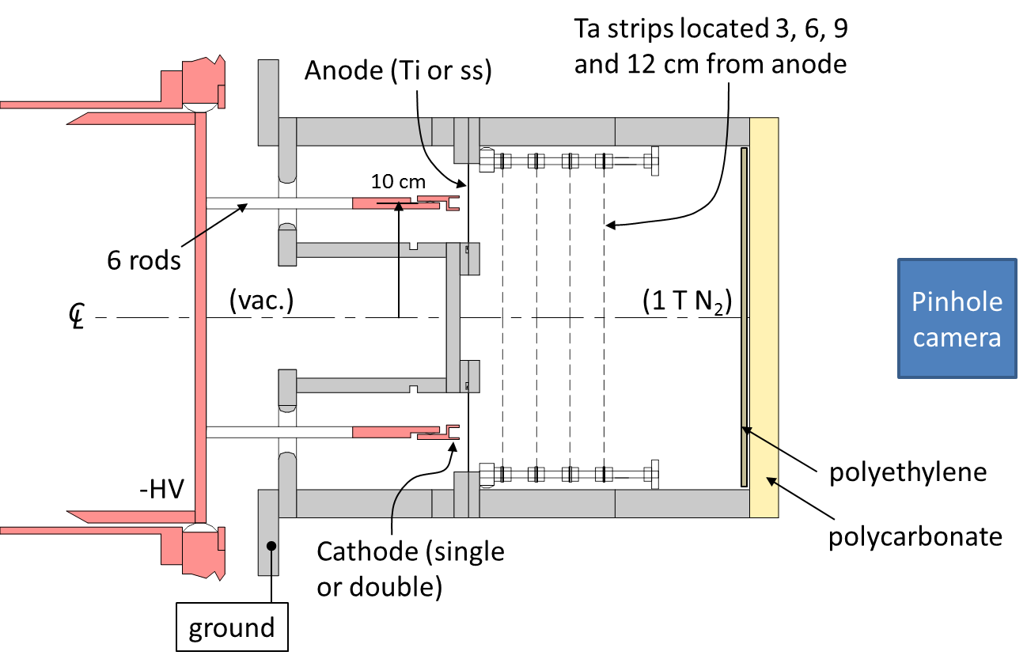
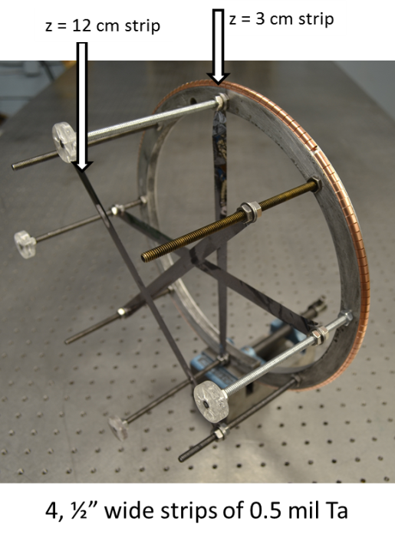
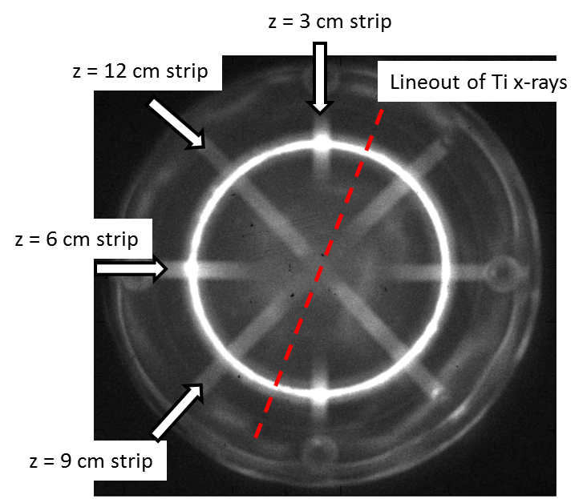
X-ray targets measuring beam propagation and spreading are compared to LSP/ABC simulations
z = 12 cm
z = 3 cm
4, 1.3-cm wide,
0.5-mil Ta strips
at z = 3, 6, 9, and 12 cm
X-ray sources in pinhole image
4-mil Ti anode
Ta strips,
0.64-cm poly witness plate at z = 25 cm
Use lineout between Ta strips to unfold x-ray intensity from Ti anode
pinhole camera photo
shot 10899

Slide 27
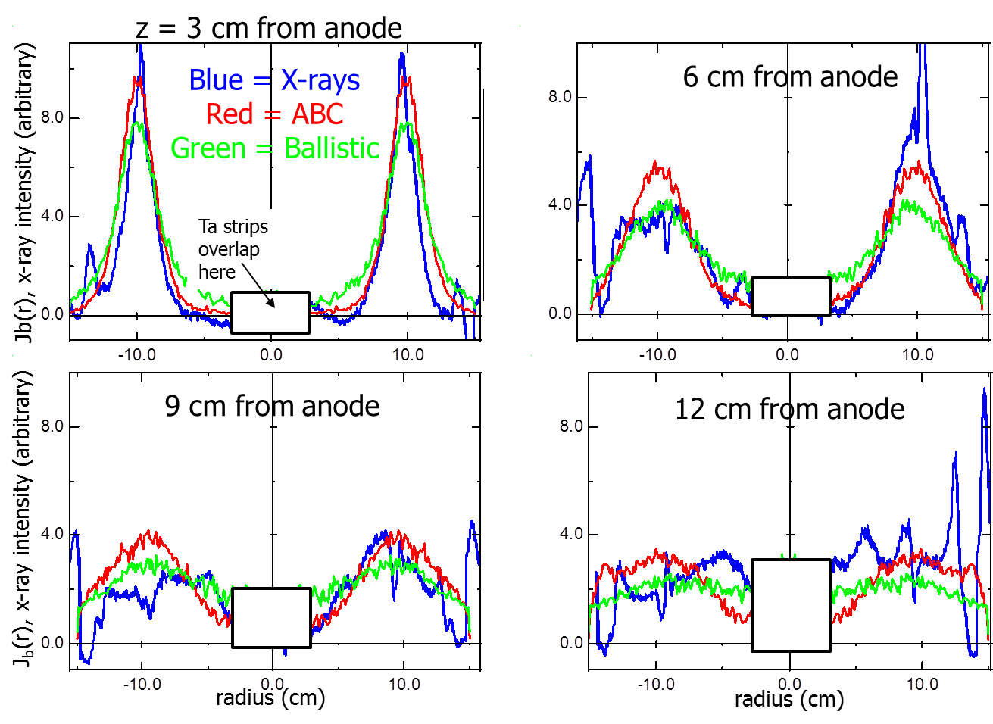
LSP/ABC simulations show good agreement with transported-beam x-ray measurements
Use I(t), V(t) from shot 10899
Inject beam onto Ti at r = 10 cm, Δr = 1 cm, normal incidence
Calculate J_{b}(r,z,t) in 1 Torr N₂ using:
ABC model in LSP (effects of scattering, gas chemistry, return currents, fields, etc.)
Ballistic assumption (scattering in anode followed by ballistic projection to strip locations)
Compare time-integrated J_{b}(r,z) with x-ray lineouts from Ta strips with ABC and Ballistic models scaled by the same factor
Transport is nearly ballistic, demonstrating good charge and current neutralization
Best agreement with ABC, where residual net current provides slight pinching to fit experiment
Comparison of Pinhole Image Lineouts with Time-Integrated J_{b} from Modeling
Beam developed azimuthal asymmetries at large z that made comparison more difficult

Slide 28
Conclusions
The ABC gas chemistry model was developed to describe nitrogen plasmas in the 1-10 Torr pressure range produced by 100-ns REBs with current densities in the 10-kA/cm² regime
Unlike models in which the gas remains weakly-ionized and molecular, this regime is characterized by nearly complete current neutralization and Joule heating driving the plasma to dissociation and high ionization
The ABC model contains 42 different nitrogen species to properly model the important kinetic processes for this plasma
ABC was coupled to a 0D circuit model that
provided good agreement with some time histories of n_{e}L and net-current measurements
reproduced scaling of n_{e}L and net-current fraction with pressure
2D LSP hybrid-simulations incorporating the ABC model added self-consistent beam dynamics, electromagnetic fields, and scattering, and
agreed with OD model electron density and net current
demonstrated excellent agreement with ring beam transport experiments at 1 Torr
Predicted poor transport at 10 Torr due to insufficient current neutralization

Slide 29
Future studies are designed to give LSP/ABC a more comprehensive predictive capability over a wider range beam and gas parameters
Perform a new experimental shot series dedicated to benchmarking the gas-chemistry model with time-resolved spectroscopy¹
In LSP, couple beam transport simulations to a diode model for more realistic beam injection conditions
radial current-density distribution
radial injection-angle distribution entering the anode foil
Investigate nitrogen gas transport at pressures in the 0.1-Torr range to assess the roles of
nonlocal effects
large Ωτ
anomalous resistivity due to two-stream instabilities
electron runaway
Couple a new time-dependent Boltzmann solver to the ABC system of rate equations to properly model low-current-density phenomena for system-response studies
1) J. Angus, et al., to be published in Physics of Plasmas, #POP48751

